Slide 1

Dictionary Learning in
Functional Brain Imaging
Xiang Li (xiangli@uga.edu)
Department of Computer Science and Bioimaging Research Center, University of Georgia, Athens, GA
cs.uga.edu/~xiang

Slide 2
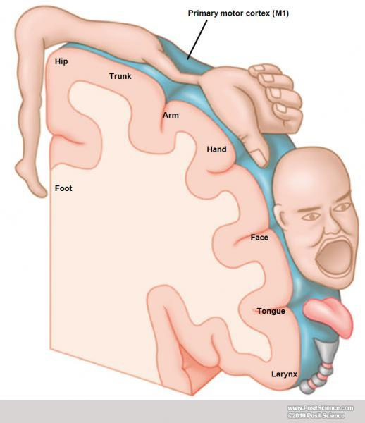
Brain Imaging
Dictionary Learning
Case Study
Discussion
Functional Brain Imaging: truths and myths
Recursive decompositions of brain cognitive capacity into increasingly smaller functional units, localized to specific brain parts (figure: motor homunculus);
Reveal the interconnection between segregated entities, as in nested distributed systems (i.e. functional integration, functional network);
Image courtesy: (upper) https://www.dynamicbrain.ca (lower) “What we can do and what we cannot do with fMRI”, Logothetis, Nikos K, Nature, 2008

Slide 3
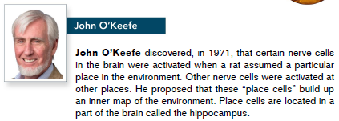
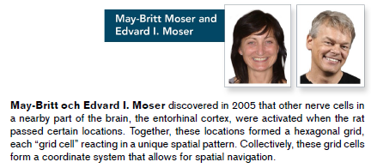
Brain Imaging
Dictionary Learning
Case Study
Discussion
Functional Brain Imaging: truths and myths
Formulating intelligent, data-based hypotheses;
Image courtesy: http://www.nobelprize.org/

Slide 4
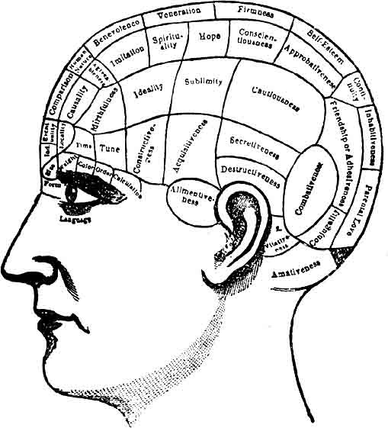
Brain Imaging
Dictionary Learning
Case Study
Discussion
Functional Brain Imaging: truths and myths
with imaging we can read minds better than direct tests of behavior;
neo-phrenology?
Image courtesy: http://uncyclopedia.wikia.com/

Slide 5
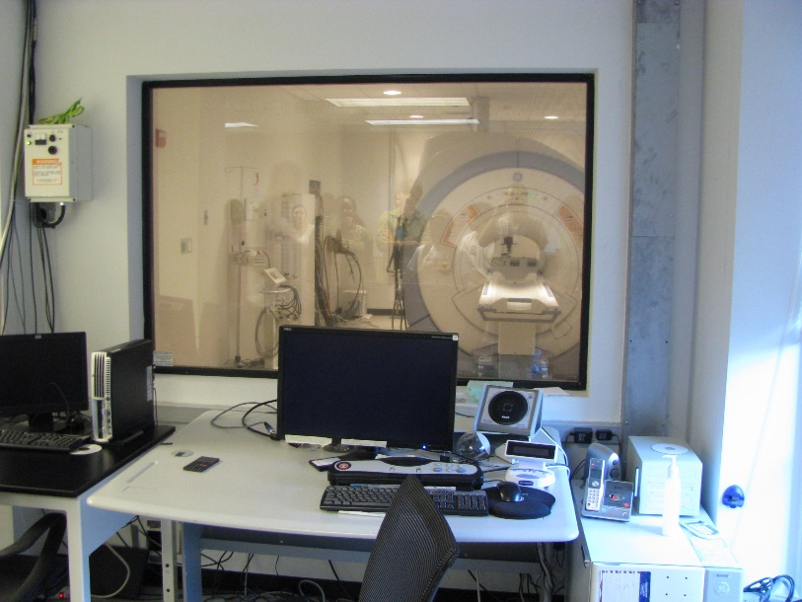
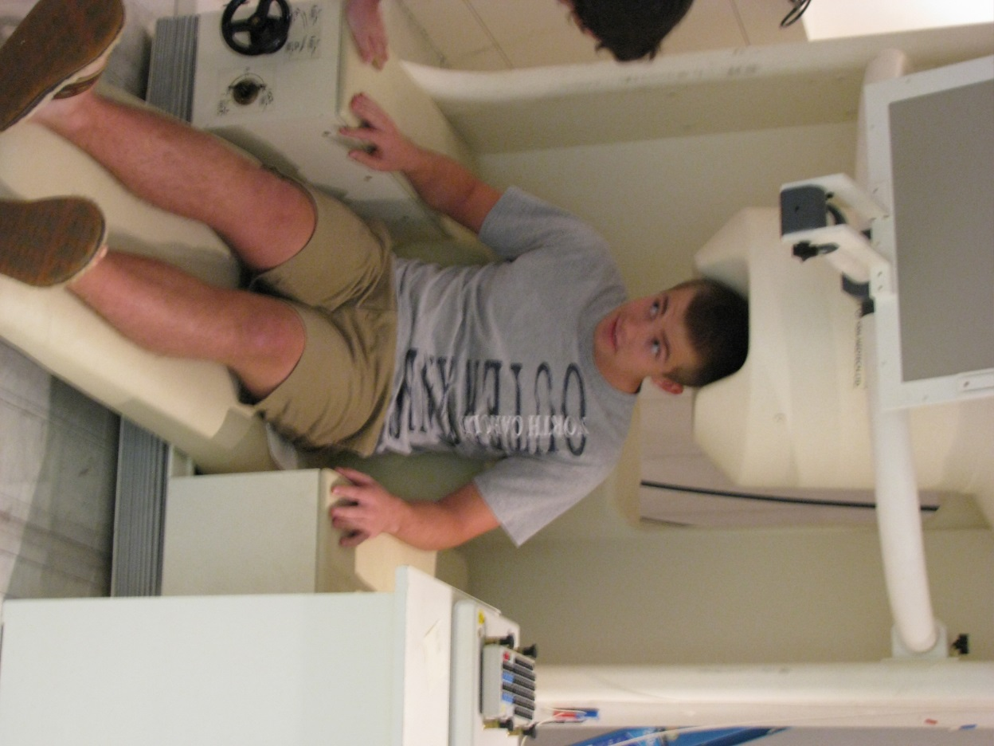
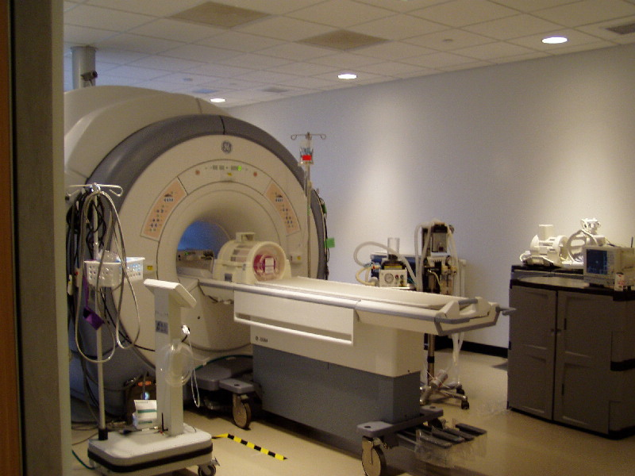
Brain Imaging
Dictionary Learning
Case Study
Discussion
Functional Brain Imaging Modalities
Image courtesy: http://birc.uga.edu/, https://kumrouga.wordpress.com/

Slide 6
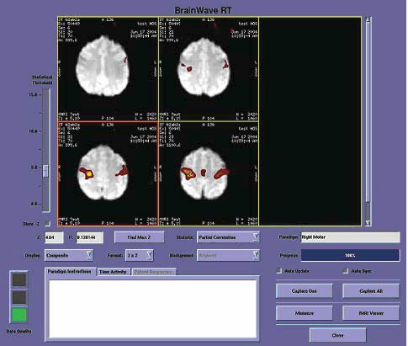
Brain Imaging
Dictionary Learning
Case Study
Discussion
Functional Magnetic Imaging (fMRI)
~14,000 voxels (number of time series) for each individual;
Hundreds of time points per time series;
~1GB per dataset (task/resting-state);
Usually the dataset contains multiple session, multiple subjects;
Image courtesy: GE Healthcare
Notes:
Two perspectives…the static perspective is more dominant…useful for psychological tests…the whole field of cognitive neuroscience is based on it…yet it lacks the power to provide in depth insight of the brain mechanism…thus we have to view the functional brain from a dynamic way…

Slide 7
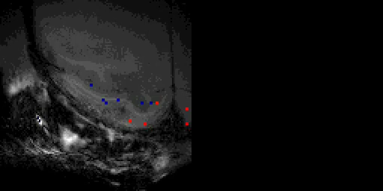
Brain Imaging
Dictionary Learning
Case Study
Discussion
Functional Brain Imaging as (big) Time Series Data
Image courtesy: https://www.dynamicbrain.ca

Slide 8
Brain Imaging
Dictionary Learning
Case Study
Discussion
Functional Brain Imaging as (big) Time Series Data
Time series matrix X, M×N
M: the number of time series;
N: the number of time points;

Slide 9
Brain Imaging
Dictionary Learning
Case Study
Discussion
Big time series data;
Can be analyzed by various machine learning techniques, e.g.
Naive Bayes classifier;
Support vector machines;
Generative Bayesian network, combining with graph theory based analysis;
Spectral clustering on the brain networks;
Traditional clustering methods for time series data;
…
Both data-driven and model-driven methods are used;
Image courtesy: http://en.wikipedia.org/wiki/Principal_component_analysis

Slide 10
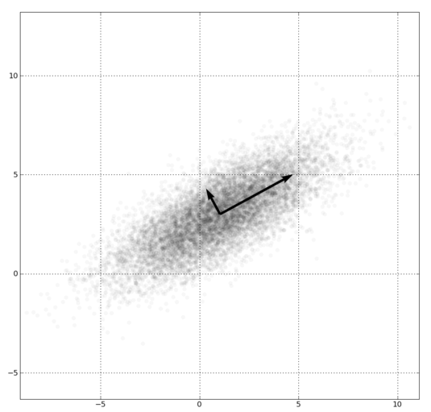
Brain Imaging
Dictionary Learning
Case Study
Discussion
Using matrix factorization-based models
e.g. Principle Component Analysis (PCA), based on the eigenvalue / eigenvectors of the matrix;
e.g. Low-rank decomposition, based on the assumption that the signal could be approximately by a reduced-ranked matrix (i.e. with fewer dimensions in the space defined by the matrix)
Image courtesy: http://en.wikipedia.org/wiki/Principal_component_analysis

Slide 11
Brain Imaging
Dictionary Learning
Case Study
Discussion
Using matrix factorization-based models
X
X₁*[1,0,0,0,0]^{T}
+
X₂*[0,1,0,0,0]^{T}
+
X
A
D
=
X₃*[0,0,1,0,0]^{T}
=
×
+
X₄*[0,0,0,1,0]^{T}
+
X₅*[0,0,0,0,1]^{T}

Slide 12
Brain Imaging
Dictionary Learning
Case Study
Discussion
Solve the following equation, finding both D and A:
Normally we need to iteratively update the D and A;
Once found, D is called a “dictionary” of X, and A is the loading coefficient of the dictionary;
Thus the model is called “dictionary learning”;

Slide 13
Brain Imaging
Dictionary Learning
Case Study
Discussion
3
2
4
2
1
0
0
0
1
1
1
1
0
1
0
0
0
0
1
0
0
0
0
1

Slide 14
Brain Imaging
Dictionary Learning
Case Study
Discussion
3
2
4
2
3
2
0
0
1
2
0
0
0
0
2
1
0
1
3
0
0
0
0
1

Slide 15
Brain Imaging
Dictionary Learning
Case Study
Discussion
3
2
4
2
3
2
0
0
1
2
0
0
6
4
0
1
0
0
2
1
2
0
0
1
0
1
3
0
0
0
0
1

Slide 16
Brain Imaging
Dictionary Learning
Case Study
Discussion
3
2
4
2
3
2
0
0
1
2
0
0
6
4
0
1
0
0
2
1
2
0
0
1
3
3
7
2
0
1
3
0
1
2
1
0
0
0
0
1

Slide 17
Brain Imaging
Dictionary Learning
Case Study
Discussion
3
2
4
2
3
2
0
0
1
2
0
0
6
4
0
1
0
0
2
1
2
0
0
1
3
3
7
2
0
1
3
0
1
2
1
0
3
5
9
7
0
0
0
1
1
0
3
7

Slide 18

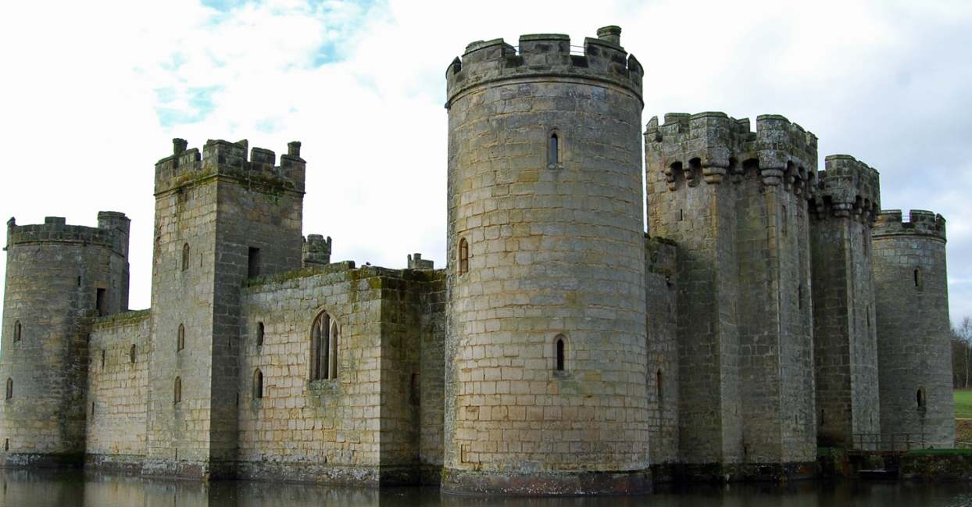
Brain Imaging
Dictionary Learning
Case Study
Discussion
Sparsity is allowed, and vital, in our cognitive process;
By sparsely building the visual optical information we acquired by our pre-knowledge on the world, we can recognize things around us without trapping in all the details;

Slide 19
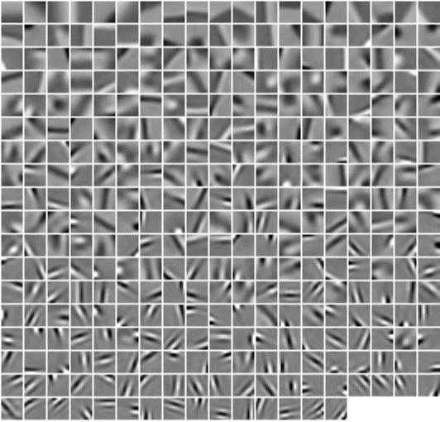
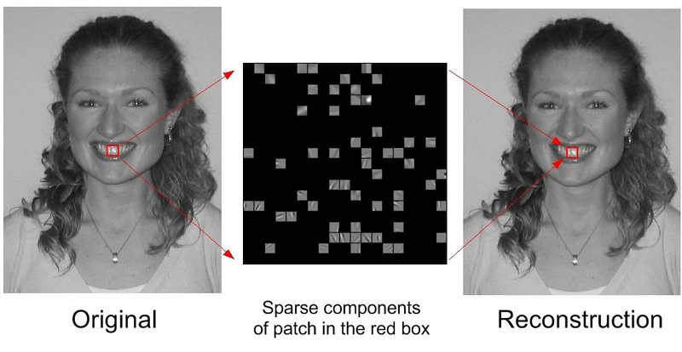
Brain Imaging
Dictionary Learning
Case Study
Discussion
Image basis learned from natural images
Consider how many “natural images” are there, the basis have an astonishing small size;
Reconstruction of the new natural image using learned basis;
Image courtesy: http://www.scholarpedia.org/article/Sparse_coding

Slide 20
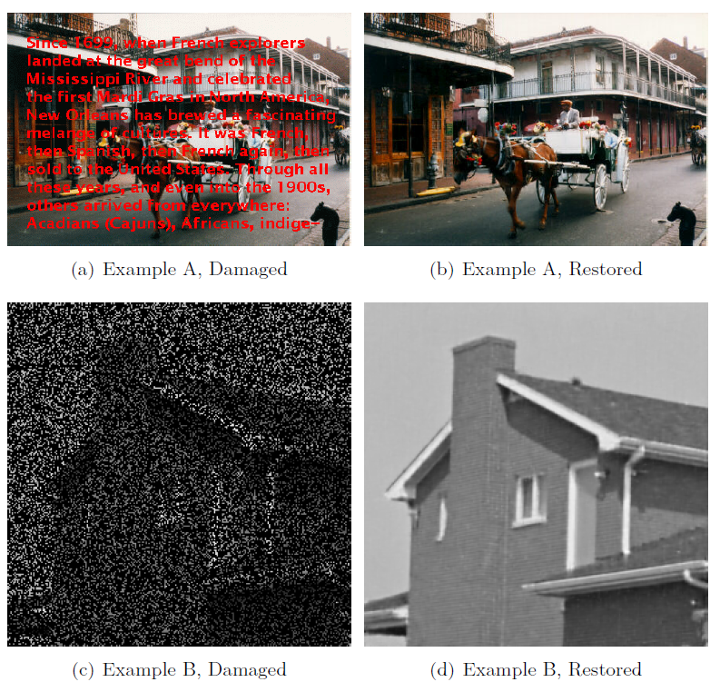
Brain Imaging
Dictionary Learning
Case Study
Discussion
Image courtesy: http://spams-devel.gforge.inria.fr/

Slide 21
Brain Imaging
Dictionary Learning
Case Study
Discussion
*Learn a full dictionary from large number of patches of natural images;
Use the dictionary to reconstruct the noisy images with l₀ regularization;
Could handle missing information smaller than the patch size;
The noise pattern is unstructured, such that no noise patterns are learned by the dictionary;
*Excerption from http://spams-devel.gforge.inria.fr/

Slide 22
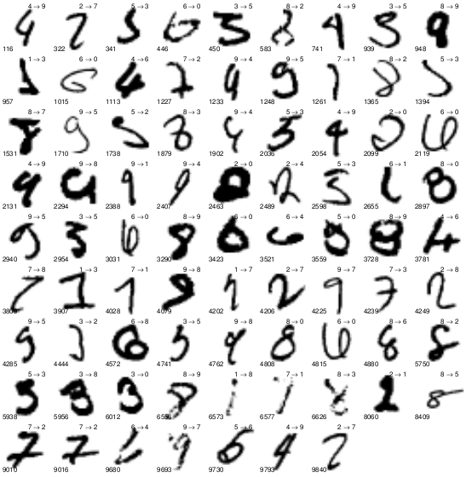
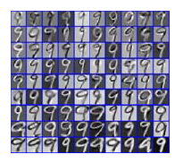
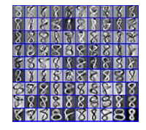
Brain Imaging
Dictionary Learning
Case Study
Discussion
Given the contextual information (e.g. class labels), the reconstruction could achieve even better performance;
Used in video surveillance data (e.g. Automatic number plate recognition);
Used in big natural image data processing (e.g. hand-written address interpretation for U.S. postal service);
Image courtesy: “Fisher Discrimination Dictionary Learning for Sparse Representation”, Meng Yang,Lei Zhang, Xiangchu Feng and David Zhang, ICCV 2011

Slide 23
Brain Imaging
Dictionary Learning
Case Study
Discussion
(Hidden) Mechanism of generating the data
Not necessarily orthogonal
Not necessarily independent
Not necessarily non-overlapping
Likely to be sparse

Slide 24
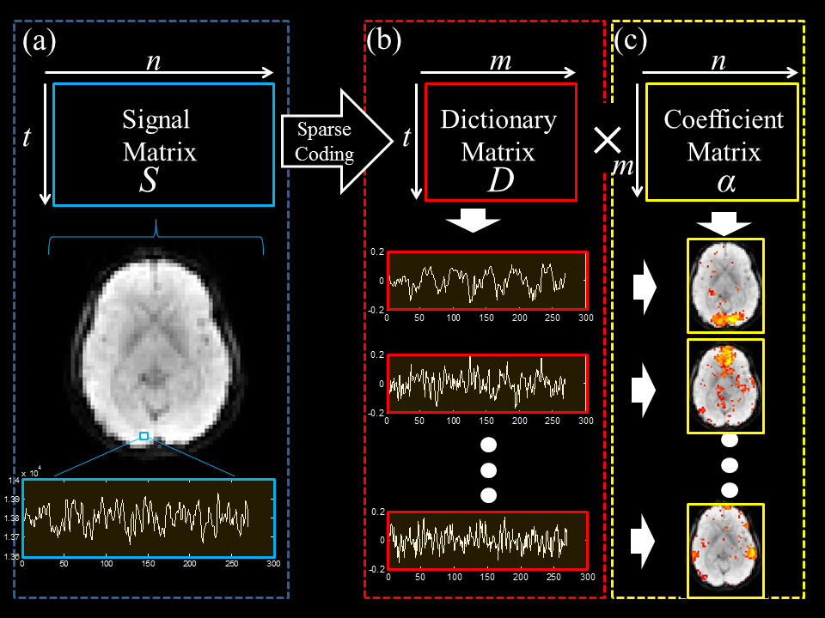
Brain Imaging
Dictionary Learning
Case Study
Discussion

Slide 25
Brain Imaging
Dictionary Learning
Case Study
Discussion

Slide 26
Brain Imaging
Dictionary Learning
Case Study
Discussion

Slide 27
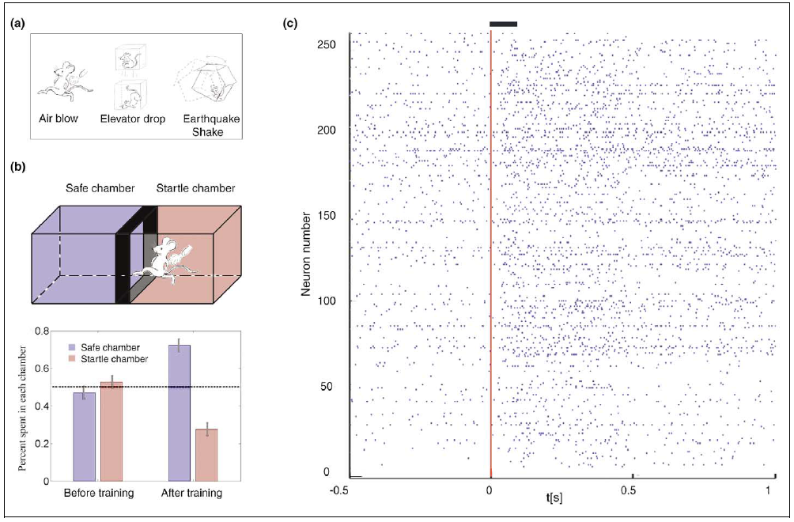
Brain Imaging
Dictionary Learning
Case Study
Discussion
Image courtesy: “Organizing principles of real-time memory encoding”, Longnian Lin1,2, Remus Osan1 and Joe Z. Tsien1 TRENDS in Neurosciences 2006

Slide 28
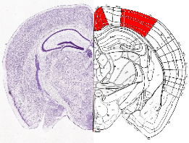
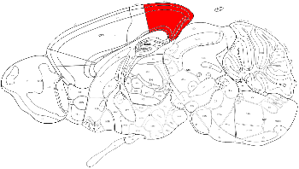
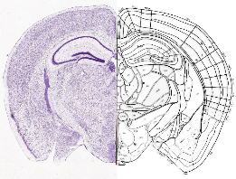
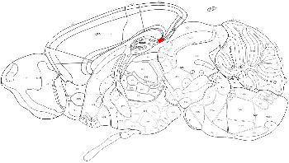
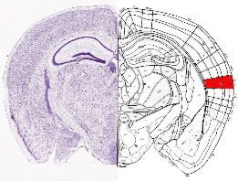
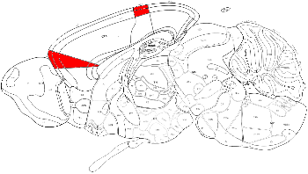
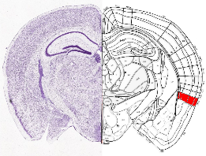
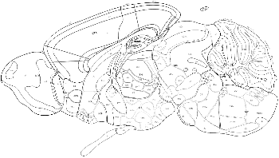
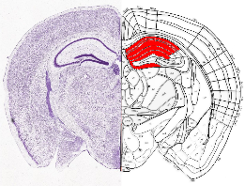
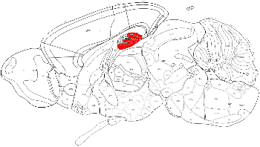
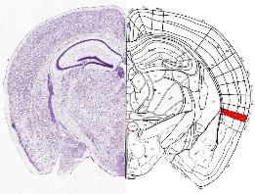
Brain Imaging
Dictionary Learning
Case Study
Discussion

Slide 29

Brain Imaging
Dictionary Learning
Case Study
Discussion
Software packages for performing dictionary learning analysis
SPAMS (SPArse Modeling Software) *
Dictionary learning and matrix factorization (NMF, sparse PCA, …);
Solving sparse decomposition problems with LARS, coordinate descent, OMP, SOMP, proximal methods;
Solving structured sparse decomposition problems (l1/l2, l1/linf, sparse group lasso, tree-structured regularization, structured sparsity with overlapping groups,...);
Download at http://spams-devel.gforge.inria.fr/downloads.html
*Excerption from http://spams-devel.gforge.inria.fr/

Slide 30
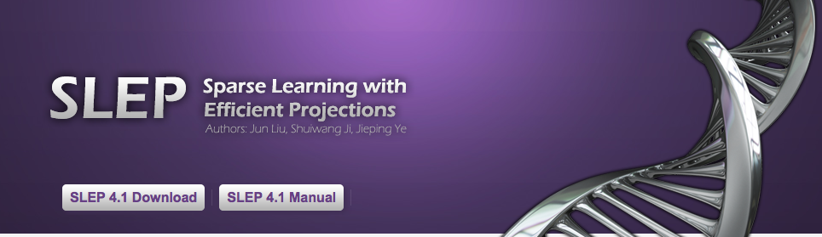
Brain Imaging
Dictionary Learning
Case Study
Discussion
Software packages for performing dictionary learning analysis
SLEP (Sparse Learning with Efficient Projections)*
Solving regularized optimization problems using first-order method, fast and large-scale!
Providing path-wise solutions (i.e. solutions corresponding to a continuous series of parameters);
Download at http://yelab.net/software/SLEP/
*Excerption from http://yelab.net/software/SLEP/

Slide 31
Brain Imaging
Dictionary Learning
Case Study
Discussion
Apply your big data strategy on functional brain imaging!
Database management;
Data distribution;
Distributed computation framework
Data analysis and knowledge discovery;
…
If you are interested, send an email to xiangli@uga.edu for a sample copy of fMRI/neuronal recording time series signal!

